Slide 1
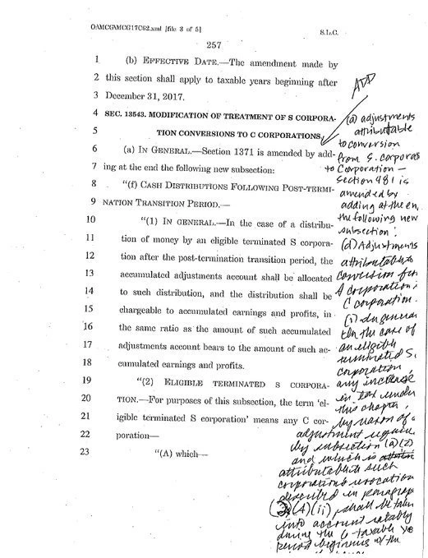
Last year, on a party line vote,

Slide 2
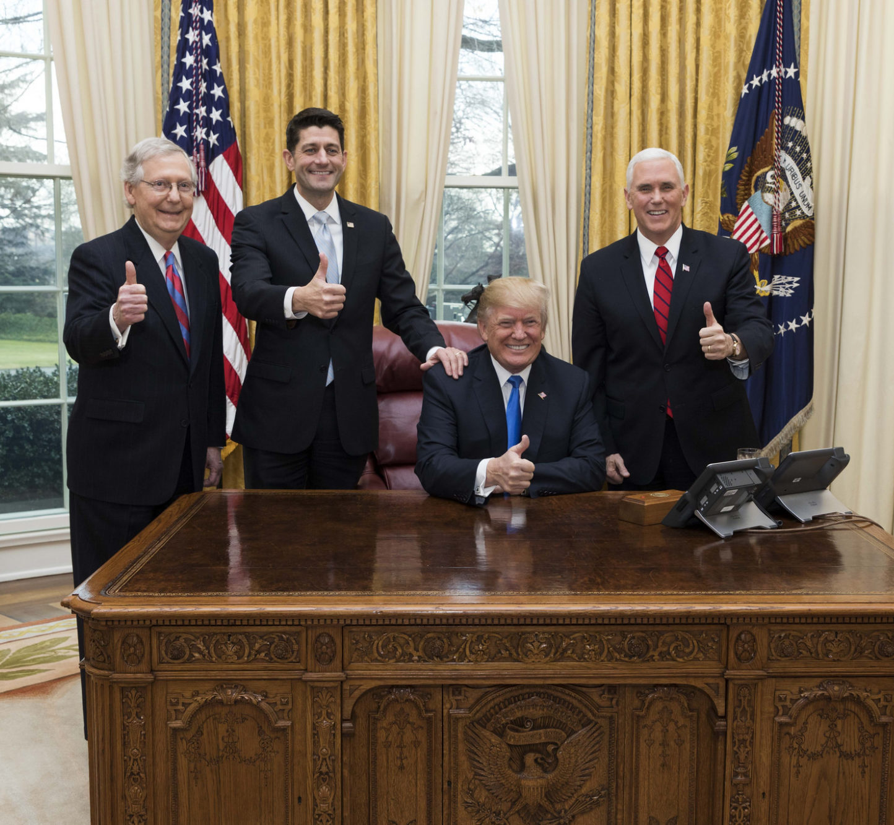
The NEW Republican Tax Code deliberately and permanently

Slide 3
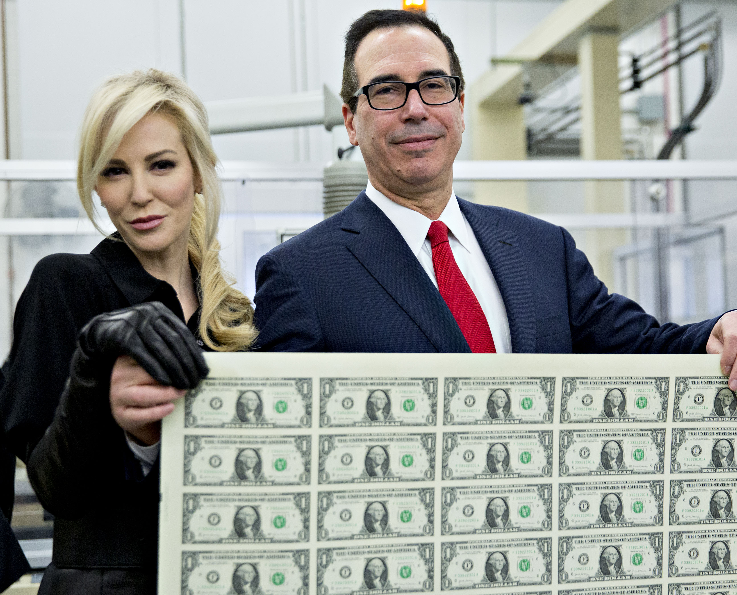
IT WAS A PAYOFF

Slide 4
329 times
$70 Billion
$67.5
Billion
$205
Million
0
Their Political
Contributions
Their Estate
Tax Cut

Slide 5
Who are these donors?

Slide 6
Donor | 2016 Fed Political Contributions | Estate Tax Cut
Sheldon and Miriam Adelson | $82,502,800 | $14,675,600,000
Paul Singer | $26,069,653 | $1,117,800,000
J. Joe and Marlene Ricketts | $15,376,788 | $835,600,00
Diane Hendriks | $14,022,900 | $2,077,800,000
Warren Stephens | $13,742,513 | $1,035,600,000
Kenneth and Anne Griffin | $13,638,140 | $3,437,800,000
Bernard and B. Wima Marcus | $11,368,450 | $1,835,600,000
Charles and David Koch* | $11,242,039 | $543,600,000
Vincent and Linda McMahon | $11,196,589 | $38,631,200,000
Richard Sr. and Helen DeVos | $3,823,097 | $2,075,600,000
Steve and Andrea Wynn | $2,043,900 | $1,275,600,000
TOTAL | $205,026,869 | $67,541,800,000

Slide 7
The tax code already favored Wall Street investors, the rich and their heirs

Slide 8
It values people who make money off investments
Hypothetical Taxpayers and their Tax Bills | Doctor | Wall Street Investor
Taxable Income | $300,000 | $300,000
Source of Income | Wages | Long-term Cap. Gains, Qualified Dividends
Federal Income Tax Due | $80,295 | $41,742
Payroll Tax Paid | $12,236 | $0
Payroll Taxes Paid by Employer | $12,236 | $0
Total Tax Burden | $104,767 | $41,742
Effective Tax Rate | 34% | 14%

Slide 9
It allows wealthy heirs to inherit millions
Hypothetical Taxpayers and their Tax Bills | Doctor | Heir
Taxable Income | $300,000 | $22,000,000
Source of Income | Wages | Inheritance
Federal Income Tax Due | $80,295 | $0
Payroll Tax Paid | $12,236 | $0
Payroll Taxes Paid by Employer | $12,236 | $0
Total Tax Burden | $104,767 | $0
Effective Tax Rate | 34% | 0%

Slide 10
The Pass-Through Deduction is a PASS-THROUGH DODGE.

Slide 11
The centerpiece of the new tax law was a

Slide 12
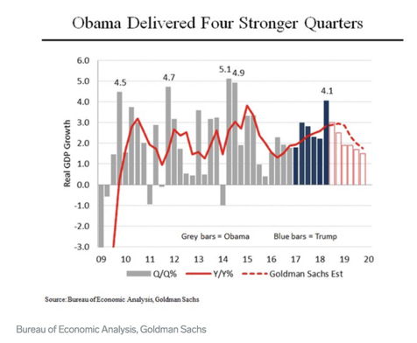
On Growth:

Slide 13
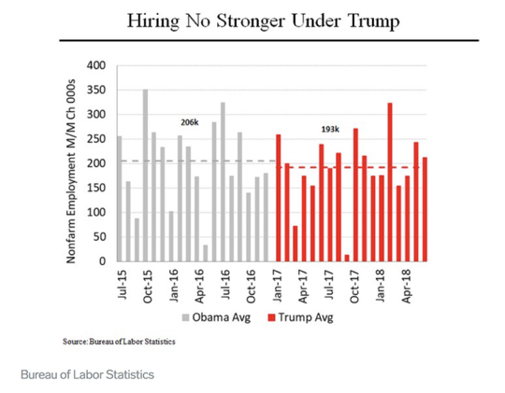
On Hiring:

Slide 14
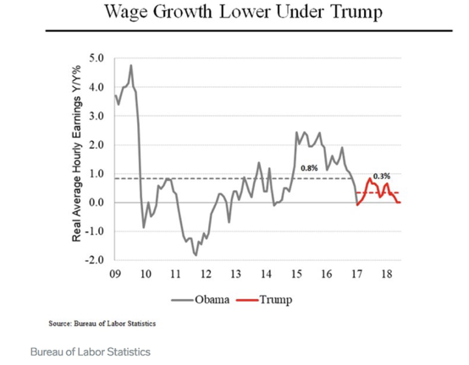
On Wages:

Slide 15
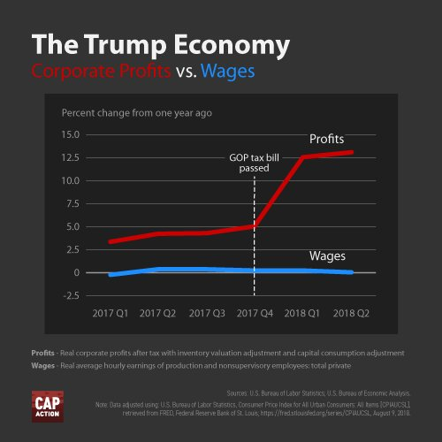
So where’s the money going?
PMUniversity.org

Slide 16
It gives corporations a tax cut to move American jobs overseas

Slide 17
The New Republican Tax Code will cost $1.9 trillion.

Slide 18
By cutting your healthcare.

Slide 19
By eliminating the ACA’s individual mandate.

Slide 20
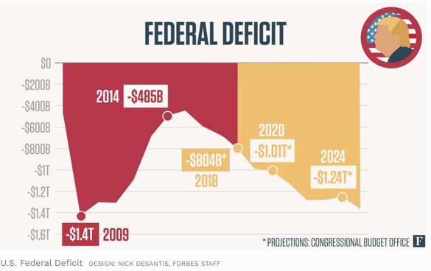
Republicans will use the deficit as an excuse to cut the social safety net

Slide 21
Through $1.4 trillion in unfunded and decaying infrastructure that we “can’t afford” to fix.

Slide 22
“This costs every American family $9 each day.”

Slide 23
And that is why the New Republican Tax Reform is

Slide 24
For more information, visit Patriotic Millionaires University
PMUniversity.org
Polling, ”Tax Basics”, Sample Stump Speech, PROVEN overperforming viral content
Request a PM to speak
“Office Hours” are all the time – we are here to HELP. Please call of email with any questions
If you haven’t applied for an endorsement yet, you can still submit an application through the PMU website
Notes:
PMUniversity.org has everything mentioned in this presentation in much more depth, and more.

